Slide 1
Fake Detect

Slide 2
Data Overview
Obama
 | # of Videos | Video Length (s) | Total # of Frames
Train Positive | 80 | 7118 | 207994
Train Negative | 500 | 3681 | 101819
Test Positive | 76 | 6720 | 196541
Test Negative (Generated Fake Video) | 117 | 2791 | 283916
Test Negative (Impersonator Video) | 2 | 417 | 12707
Test Negative (Politician Video) | 6 | 9509 | 194990
Trump
 | # of Videos | Video Length (s) | Total # of Frames
Train Positive | 14 | 1207 | 35257
Train Negative | 197 | 3681 | 101819
Test Positive | 12 | 1027 | 23838
Test Negative (Generated Fake Video) | 73 | 1184 | 121328
Test Negative (Politician Video) | 6 | 9509 | 194990

Slide 3
Feature Analysis Test Negative: generated fake videos [FaceSwap using targets’ masks]
Sequence = 100 Frame, Overlap = 10 Frame
 | Trump | Obama
All Feature | 0.658025 | 0.30054
Location of the head wrt camera | 0.676117 | 0.29845
Head rotation | 0.819682 | 0.465786
Lip gap/width | 0.984704 | 0.992473
Eye gaze direction | 0.682071 | 0.892383
Eye blink | 0.703402 | 0.875203

Slide 4
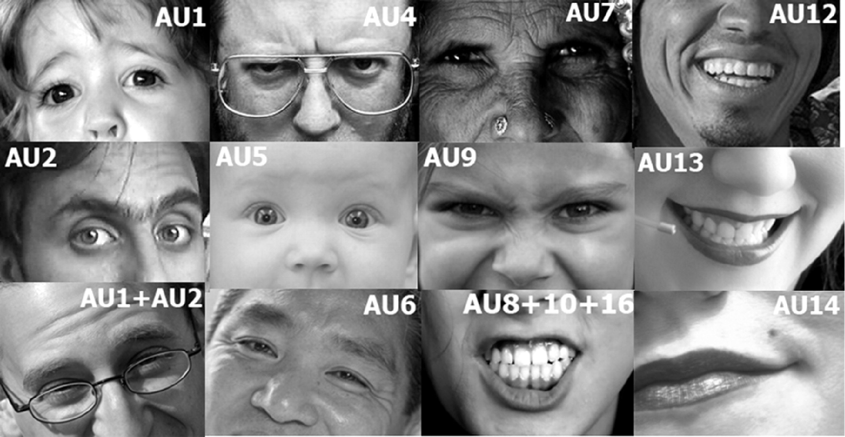
Feature – FAU
https://www.cs.cmu.edu/~face/facs.htm

Slide 5
Feature Analysis - FAU Test Negative: Generated fake videos using targets’ (Obama) faces as masks
Frame | Overlap
50 | 10
100 | 10

Slide 6
Feature Analysis - FAU Sequence = 100 Frame, Overlap = 10 Frame Test Negative: Generated fake videos with Obama mask vs. Other Politician(Hillary)
FaceSwap Fake Videos for Obama
Other Politician (Mixed)

Slide 7
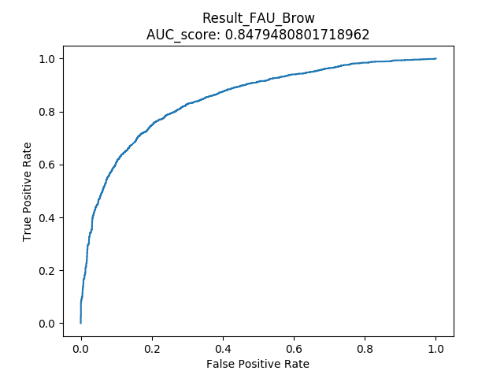
Feature Analysis - FAU FAU: Brow-related [1,2,4]
Sequence = 100 Frame, Overlap = 10 Frame Test Negative: Generated fake videos with Obama mask
Lips | All FAU | Brow FAU

Slide 8
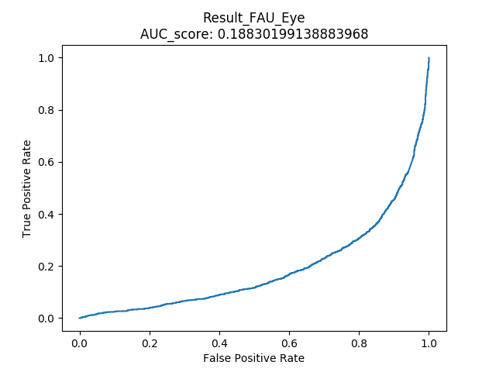
Feature Analysis - FAU FAU: Eye-related [5,45]
Sequence = 100 Frame, Overlap = 10 Frame Test Negative: Generated fake videos with Obama mask
Lips | All FAU | Eye FAU

Slide 9
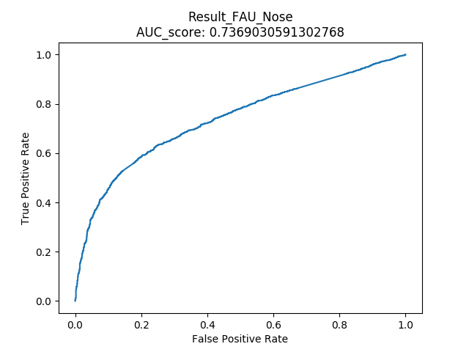
Feature Analysis - FAU FAU: Nose-related [9]
Sequence = 100 Frame, Overlap = 10 Frame Test Negative: Generated fake videos with Obama mask
Lips | All FAU | Nose FAU

Slide 10
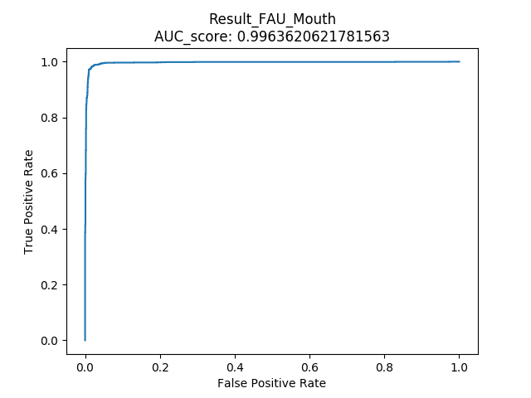
Feature Analysis - FAU FAU: Mouth-related [10,12,15,20,23,25]
Sequence = 100 Frame, Overlap = 10 Frame Test Negative: Generated fake videos with Obama mask
Lips | All FAU | Mouth FAU

